Slide 1
Disc 3: Recursion & Tree Recursion
Kevin Wang

Slide 2
Slides:
links.cs61a.org/kevin-slides

Slide 3
Administrivia
Midterm 1 Grades are out
Hog Contest (optional) due Monday 2/22
HW 3 due Thursday 2/21!
No lab due this week

Slide 4
Administrivia Cont.
CSM sections! Sign up by filling out the survey on Piazza!
If you’d like to meet one-on-one to talk about the course feel free to email me! kwang626@berkeley.edu

Slide 5
Recursion

Slide 6
A recursive function is a function that calls itself

Slide 7
3 Steps to a recursive function
Base case: What is the simplest argument we could possibly get. Ex: 0
There can be more than one base case!
Recursive call: What is a simpler problem we could solve?
Make sure this simpler problem is moving towards your base case!
Put it all together: How do we use our solution from step 2 to solve our current problem?

Slide 8
Example: recursive factorial
The simplest input for the factorial function is 0, in which 0! Its 1
What is a version of this problem that is one step simpler?
factorial(n - 1)
If we have factorial(n - 1), how can we use that to get factorial(n)?

Slide 9
Example: recursive factorial
The simplest input for the factorial function is 0, in which 0! Is 1
What is a version of this problem that is one step simpler?
factorial(n - 1)
If we have factorial(n - 1), how can we use that to get factorial(n)?
def factorial(n):
# Base Case
if n == 0:
return 1
else:
# Recursive Case + putting
# it all together
return n * factorial(n - 1)

Slide 10
Iteration vs Recursion
Keep repeating a task until “done”
Easy to visualize
Looping occurs in the same frame.
demo
Break a problem up into smaller pieces
Can take a lot of memory and hit max recursion depth errors.
Some problems are easier to solve with recursion: tree problems, fib
demo

Slide 11
Worksheet!

Slide 12
Tree Recursion

Slide 13
Recursion with more than one recursive call

Slide 14
Tree Recursion Cont.
Def fib(n):
# Base Case:
if n == 0:
return 0
elif n == 1:
return 1
Else:
# Recursive call + putting it
# all together
return fib(n - 1) + fib(n - 2)
Useful when you need to think of multiple ways to break down the problem at the same time.
Typically also used when you have multiple choices and want to explore all of them.
Ex: Fibonacci

Slide 15
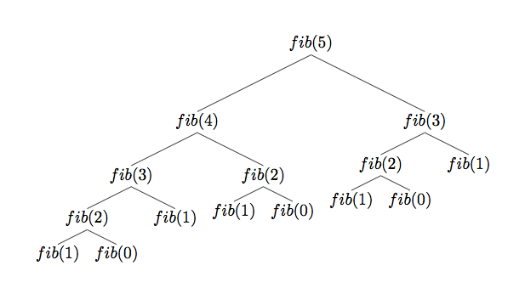
This is what fib(5) looks like

Slide 16
Worksheet!

Slide 17
Attendance:
links.cs61a.org/kevin-disc

Slide 18
Zipper (from the midterm)

Slide 19
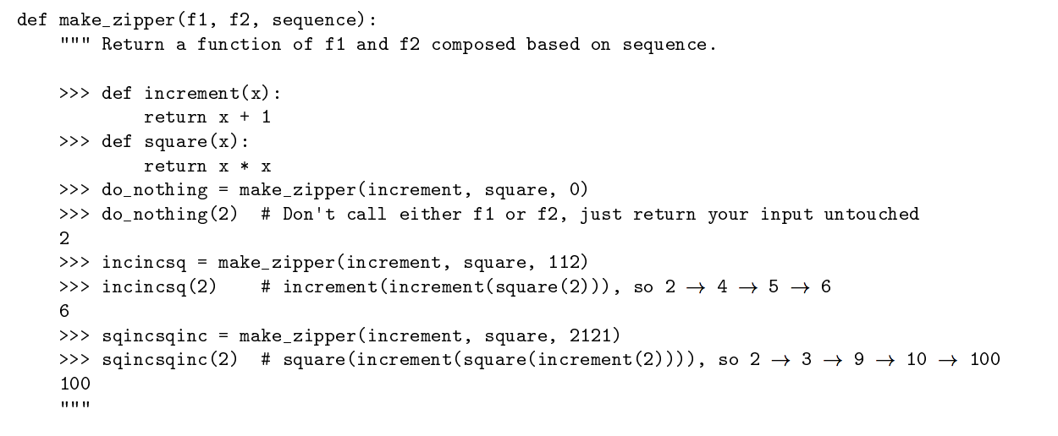

Slide 20
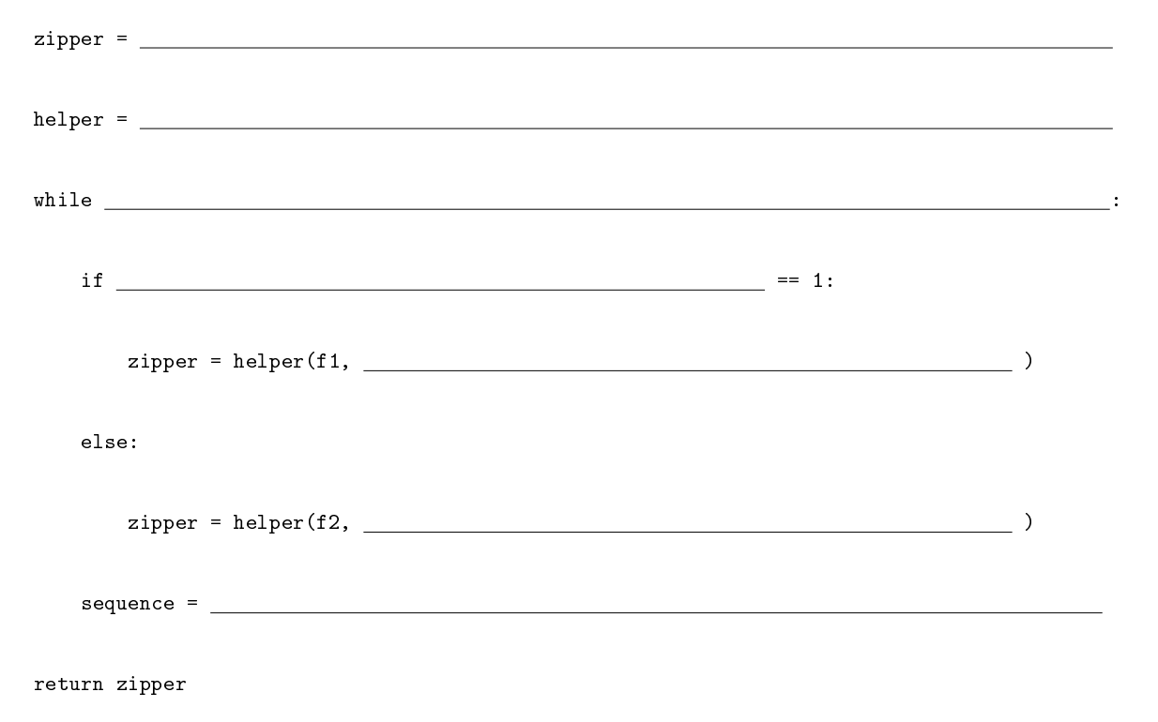

Slide 21
